Slide 1
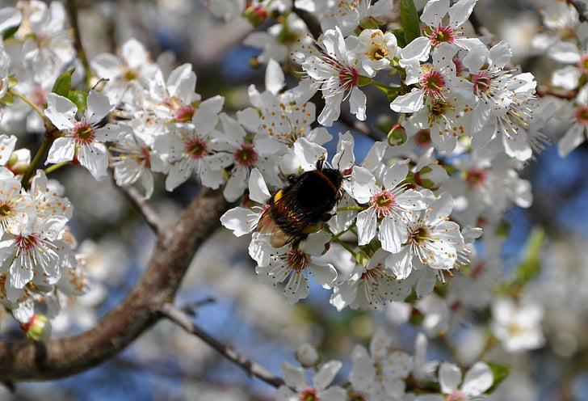
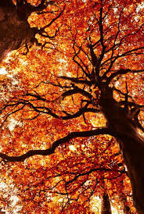
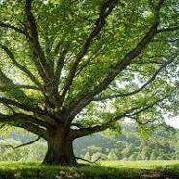
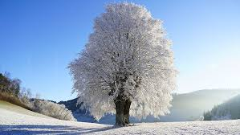
TREE DAY 2024
By,Padraig,Kian, Kevin and Ben

Slide 2
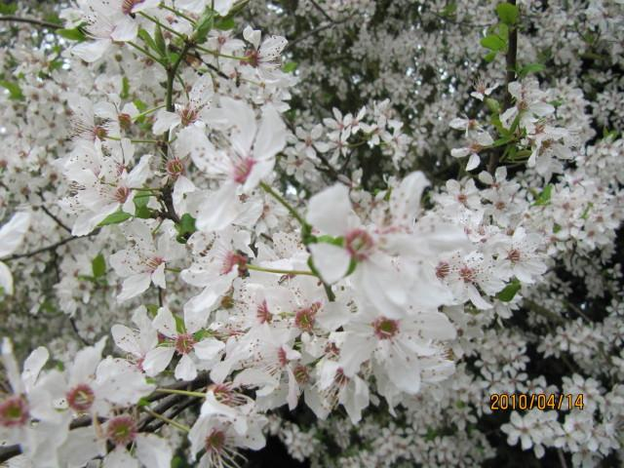
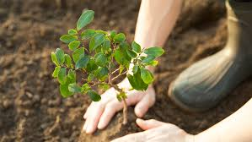
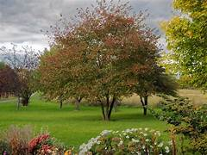
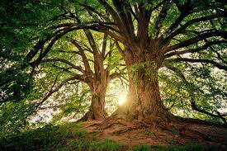
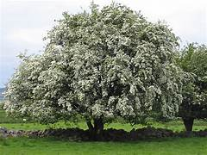
The tree this year is
The Hawthorn Tree

Slide 3
Facts about the hawthorn
The Hawthorn tree is a thorn tree that was planted in hedges throughout our countryside.
It's sweet blossom appears in May and in Autumn.
In winter it has a fruit that is a deep red Haw berry.
The tree produces berries that birds love to eat.

Slide 4
Where they grow….
.
Like many other trees, hawthorn also grows
In woodland where there is enough light
In open land
Along the edge of hedges

Slide 5
The fruit on the hawthorn
Only untrimmed hawthorn can flower and fruit freely, but hedges have to be cut to keep them safe.
Even old hawthorn hedges will regenerate if trunks are cut back to base and left to sprout again, but these must be fenced off so that farm livestock cannot reach the tasty young shoots and eat them.

Slide 6
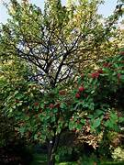
SOWING SEEDS
Seeds should be sown thinly in nursery rows.
Seedlings left for 1 - 2 years until ready to transplant and grow for a further 1 - 2 years before setting out in permanent sites.

Slide 7
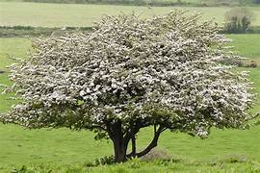
How to grow a hawthorn
https://www.youtube.com/watch?v=9wJoPfTFXIU
Hawthorns are best planted when dormant, from autumn to spring, as bare-root trees or hedging plants. The best method of propagating hawthorns is from seed, saved from the haws or berries. It takes a long time, but start by mashing the berries to extract the seed and mix with sand. Sow in fine compost mixed with leaf mould, in pots.

Slide 8
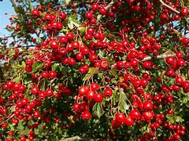
All about hawthorn berries
People may consume hawthorn berries or take them as an extract. However, a person should talk with their doctor before consuming hawthorn berries or extract. Hawthorn is a wild tree that produces edible berry-like fruits. These fruits may have some health benefits.

Slide 9

The end

Slide 10
Do you think we are done

Slide 11


Slide 12
Do not forget

Slide 13

The Tree themed

Slide 14
Questions
How many different types of hawthorn trees are there.
Are the berries edible of the hawthorn tree?
How long should you leave the seed for
what is the best method to grow a hawthorn
What are the interesting facts about the hawthorn tree?
What is the best time to plant a hawthorn
Can old hawthorns regenerate when cut
Name three places that a hawthorn can grow

Slide 15
The answers
2
yes
1 to 2 year
Mashing up
The flowers on the tree smell very nice
Hawthorns are best planted when dormant, from autumn to spring,
Yes
In woodland where there is enough light In open land Along the edge of hedges

Slide 16

Now the end

